Slide 1
Respondent-Driven Sampling: An Overview
Ashton M. Verdery
Duke Network Analysis Center
May, 2018

Slide 2
Outline
Leveraging social networks for sampling
Why?
How?
What is RDS?
Hidden populations
RDS origins and concepts
RDS applications
Pitfalls and promises of RDS

Slide 3
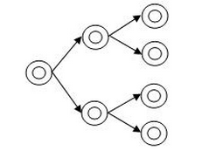
Samples from social networks

Slide 4
Importance
Future of social science research
New populations of interest hard to survey
e.g., undocumented migrants, drug users
New analytic tools require new & complex data
e.g., social network analysis
Existential threat of declining survey participation
i.e, all groups are becoming hidden populations

Slide 5
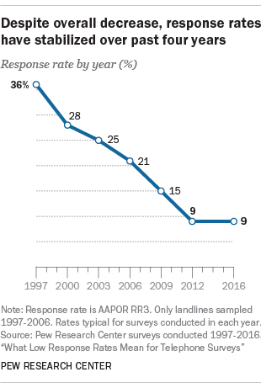
Silliness
http://www.pewresearch.org/2017/05/15/what-low-response-rates-mean-for-telephone-surveys/

Slide 6
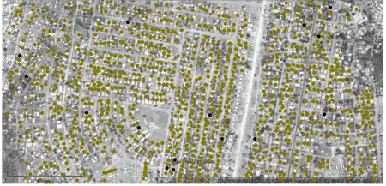
Hidden populations
Collecting data from hidden populations is difficult because the absence of a sampling frame
Stigma
Non response
Lack of trust
Rarity
Household based sampling in Lilongwe, Malawi
Escamilla et al. 2014

Slide 7
How to sample hidden populations?
Traditional approaches
Convenience samples
Clinical samples
Location samples
Problems
Are we learning about people other than those sampled?
Limited ability to infer representation
Poor coverage for sampling frame
Often time intensive, costly, very small samples

Slide 8
Respondent-Driven Sampling (RDS)
A sociological method with wide applications
Heckathorn 1997
Most popular solution to problems of hidden populations in recent decades (as of May 2018)
510+ studies
1.1k+ papers, 20k+ cites
Over $200 mill. from NIH
Compare to “ego centric”
231 studies funded
$52 million since 1990

Slide 9
RDS applications
Hidden populations of many stripes
Men who have sex with men
People who inject drugs
Commercial sex workers
High risk heterosexuals
Other drug users (opioids, methamphetamines)
Domestic violence victims
Victims of sexual violence (child prostitution, sex trafficking, war-time rape)
Jazz musicians
Vegetarians and vegans in Argentina
Wheelchair users
Non-institutionalized older adults (85+)
Most common questions
Can we sample this population?
What are the characteristics of this population?
What is the size of this population?

Slide 10
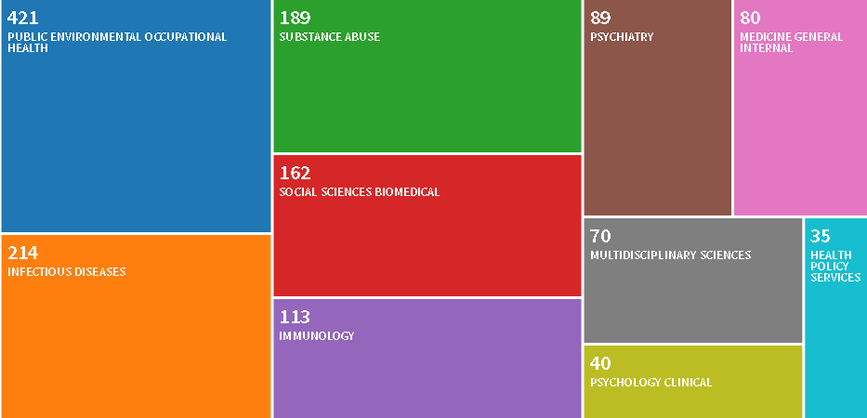
Top 10 fields
Web of Science. May 2018.

Slide 11
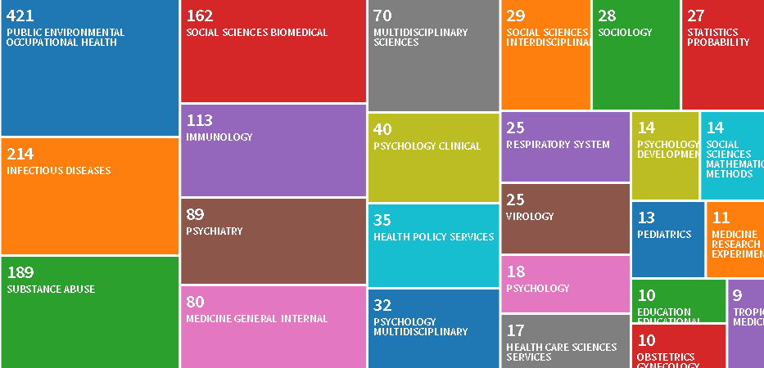
Top 25 fields
Web of Science. May 2018.

Slide 12
RDS overview
Two parts
1) Chain referral / peer recruitment
“Seed” participants receive two coupons
Recruit two new participants each
Dual incentives for participation & recruitment
Each new respondent given 2 coupons to recruit others
Process continues until desired sample size is obtained
(No one participates more than once)
*Researchers lack control of sampling process
2) Post-recruitment weighting of cases
Correct for theoretical sampling probabilities

Slide 13

Seeds & coupons
Seeds
7-10 population members
Convenience selection
Willing to participate
Large personal networks
Diverse on relevant attributes
Distribute coupons
2 to 3 per respondent
Uniquely coded for tracking
Codes given out & redeemed
Non-physical coupons
Possible, but challenging
Wirtz et al. 2017

Slide 14
Coupons
Contact number
Consent and study
description (on back)
Valid dates
Interview site location
Tracking codes

Slide 15
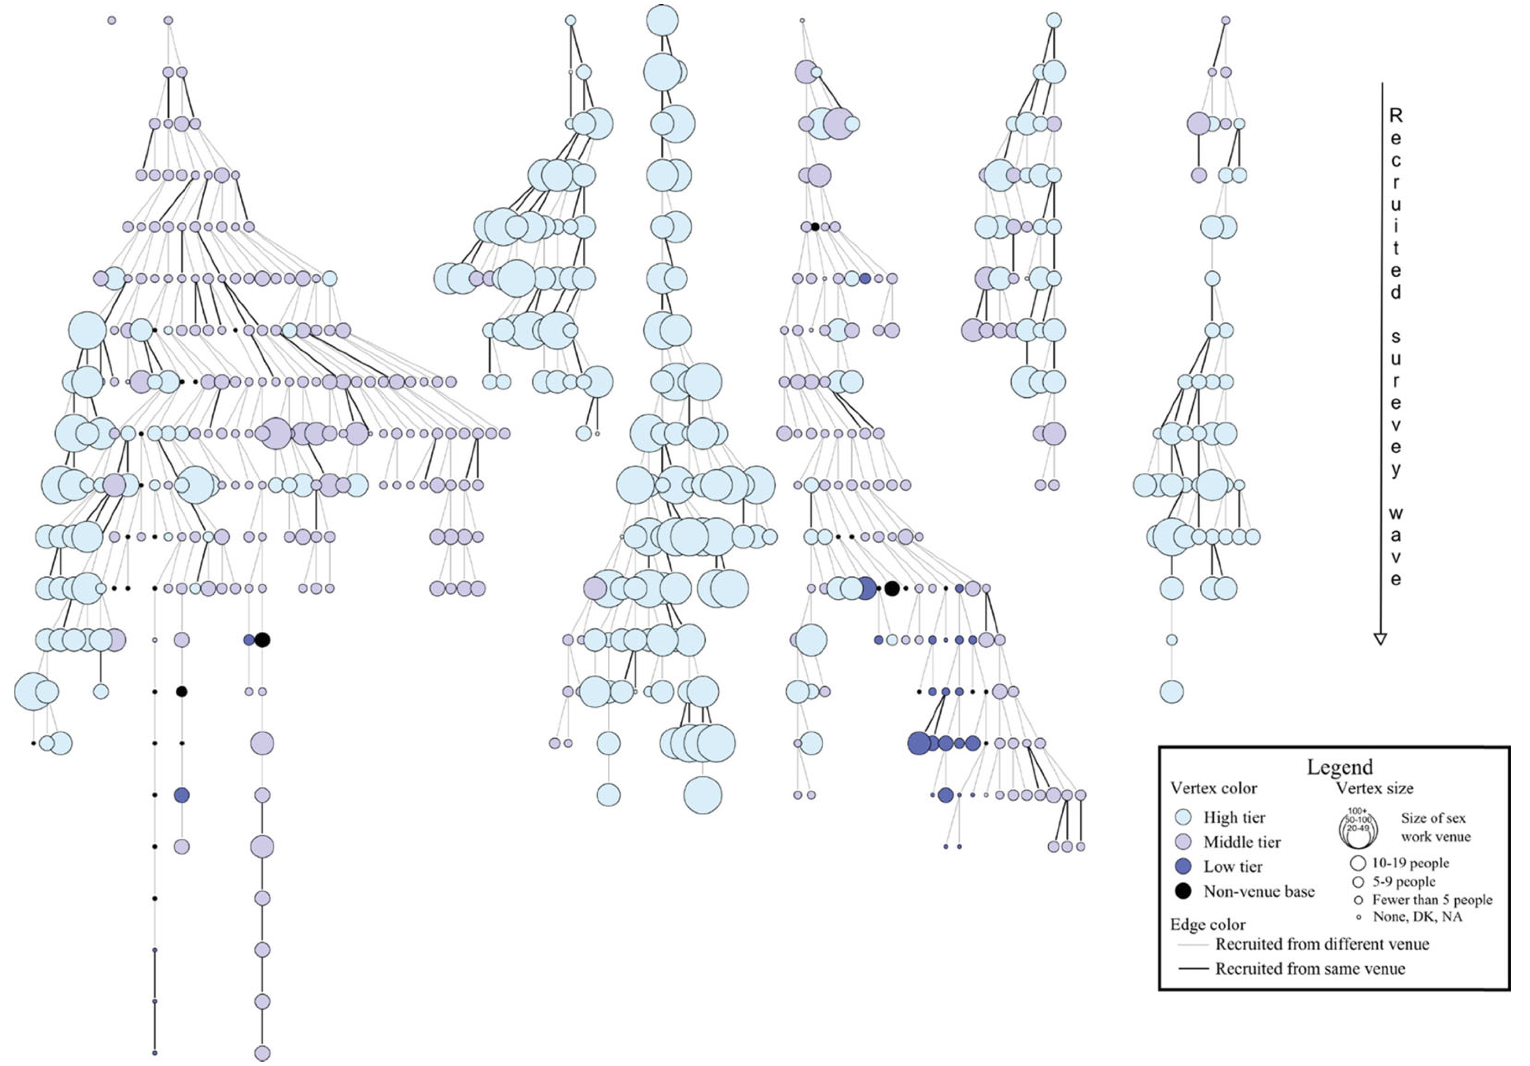
Example
(Fisher and Merli, Net. Sci. 2014)

Slide 16
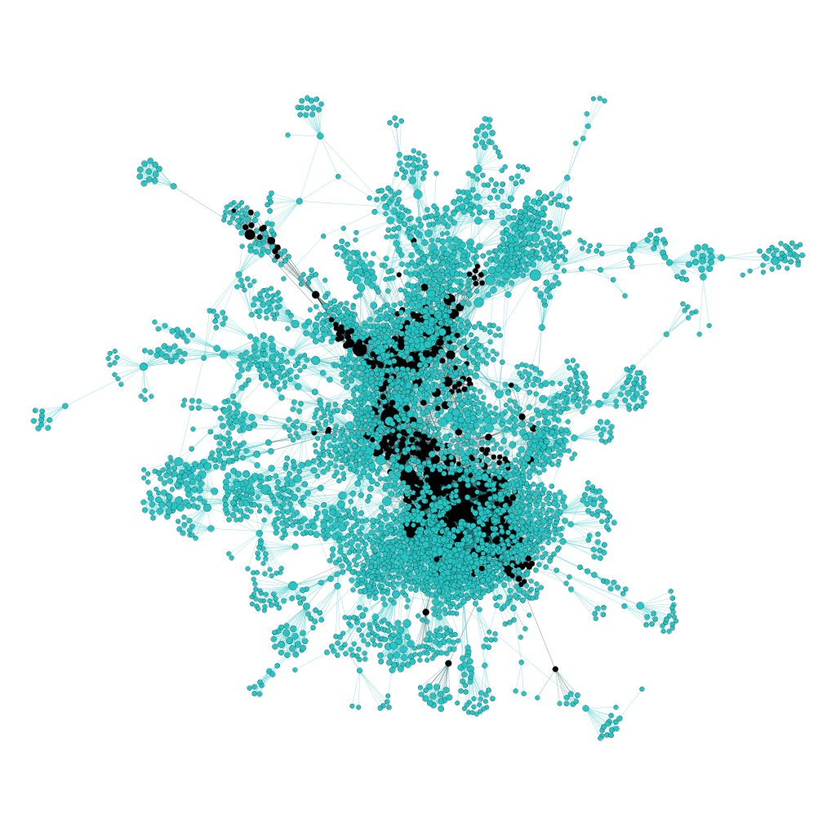
Example
Sampled = black
(Verdery, et al Soc. Meth. 2017)

Slide 17
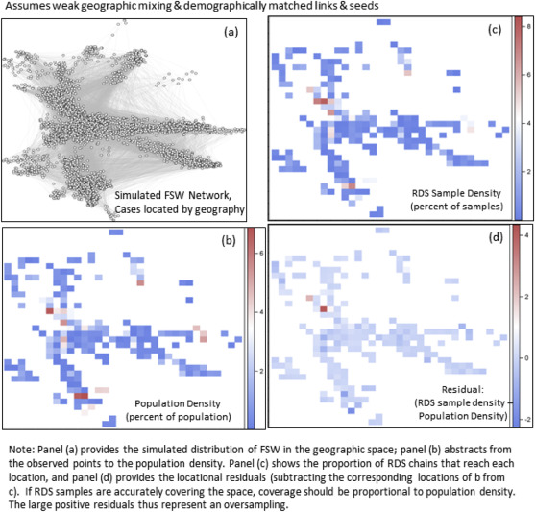
Example
(Merli, et al Soc. Sci. Med. 2015)

Slide 18
Core resources
Useful website from Handcock & collaborators
http://hpmrg.org
Manuals for RDS survey design
Johnson tutorial, with questionnaires, consent forms, etc.
http://applications.emro.who.int/dsaf/EMRPUB_2013_EN_1539.pdf
CDC, UNAIDS, and others also have useful manuals
https://www.cdc.gov/hiv/pdf/statistics/systems/nhbs/nhbs-idu3_nhbs-het3-protocol.pdf
https://globalhealthsciences.ucsf.edu/sites/globalhealthsciences.ucsf.edu/files/ibbs-rds-protocol.pdf
Software for RDS analysis
R package “RDS”
https://cran.r-project.org/web/packages/RDS/index.html
RDS analyst and coupon manager, stand alone software for RDS:
http://www.respondentdrivensampling.org/main.htm
Stata packages
http://www.stata-journal.com/article.html?article=st0247
I have unreleased Stata packages for many RDS estimators and RDS multivariate regression
Fisher’s step-by-step guide to making beautiful RDS plots in Pajek
Diagnostics for RDS preplanning and post-survey analysis
http://www.princeton.edu/~mjs3/gile_diagnostics_2014.pdf

Slide 19
Key concepts & assumptions
Baseline assumptions
People in the population know other population members and will refer them into the study
Key concepts
Primary & secondary interviews
Bias, sampling variance, & RMSE
Estimates vs. parameters
Respondent degree
Random recruitment
Bottlenecks
Different estimators make different assumptions
Table provides general list
Not all estimators make each
Network structure assumptions
There is a social network
Population size large (N>>n)
Homophily weak
Community structure weak
Connected graph w/1 component (giant component)
All ties reciprocated (undirected)
Known population size N
Sampling assumptions
Sampling with replacement
Single, non-branching chain (1 seed; 1 coupon)
Sufficiently many sample waves
Initial sample of seeds unbiased
Degree accurately measured
Conditionally random referrals (random recruitment)
(see Gile 2011:144)

Slide 20
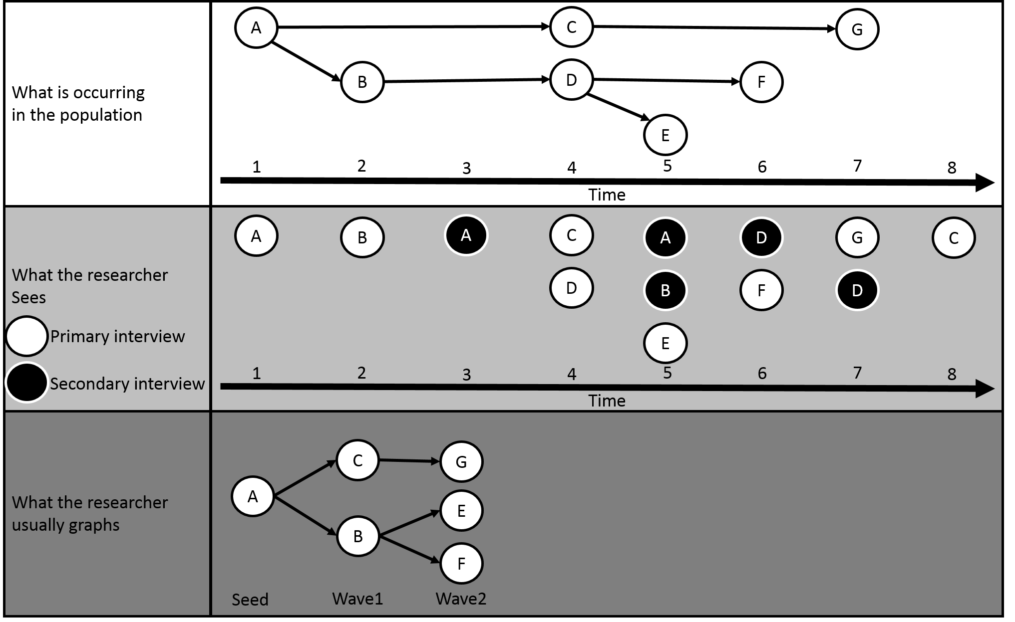
Primary & secondary interviews

Slide 21
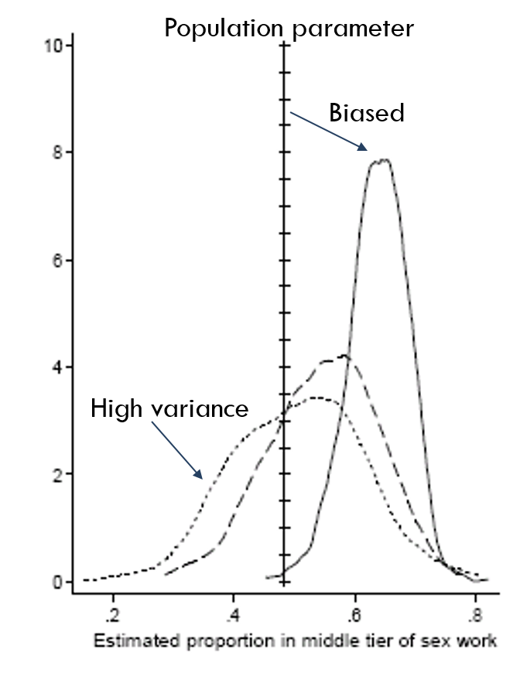

Key concepts
Where $a$ is number of samples, ${\hat{c}}_{i}$ is the estimated statistic from sample $i$, and $C$ is the population parameter:
Bias
$bias=a^{−1}\sum_{i=1}^{i=a}{\left(\hat{c_{i}}−C\right)}$
“Accuracy”
Sampling variance
$SV= a^{−1}\sum_{i=1}^{i=a}{{\left({\hat{c}}_{i}−a^{−1}\sum_{j=1}^{j=a}{{\hat{c}}_{j}}\right)}^{2}}$
“Precision”
Root Mean Square Error (RMSE)
$RMSE=\sqrt{({bias}^{2}+SV)}$
Balancing accuracy and precision
There are many other error metrics; I like this
Design effects
${DE={SV}_{RDS}}/{{SV}_{SRS}}$
Precision ratio compared to simple random samples
Sample size ratios for equivalent efficiency
Just right?
Verdery, Merli, et al. Epid. 2015.

Slide 22
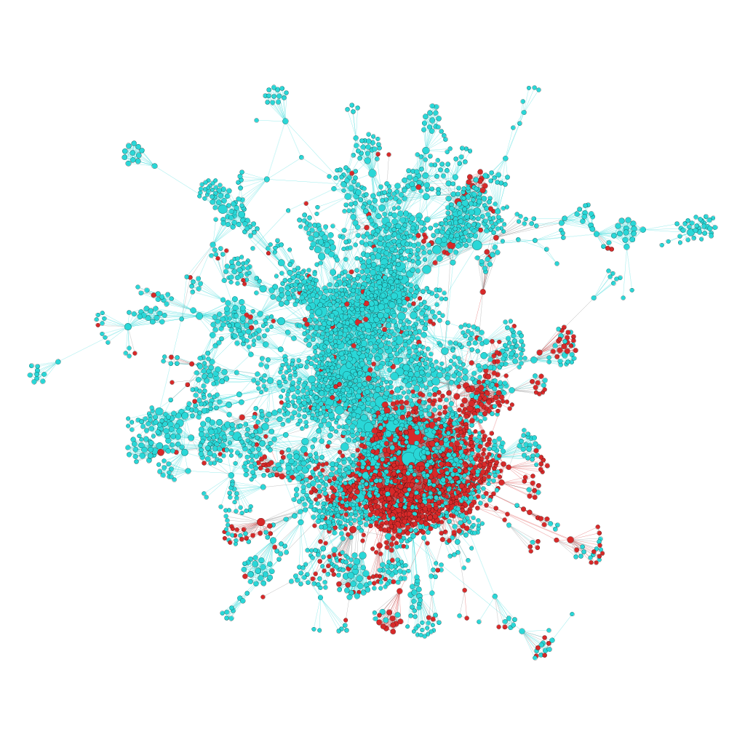
Contrast with SRS
Network: Project 90 (N=4413)
Variable: Percent White
RDS
Unbiased, 10 seeds, 3 coupons
Without replacement
N=150
SRS
Without replacement
n=150
Project 90 network, red nodes=non-white
Verdery et al. 2017

Slide 23
Contrast with SRS

Slide 24
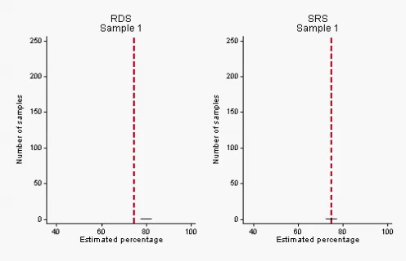
Contrast with SRS
Backup: https://youtu.be/BZL3XBeG7W8

Slide 25
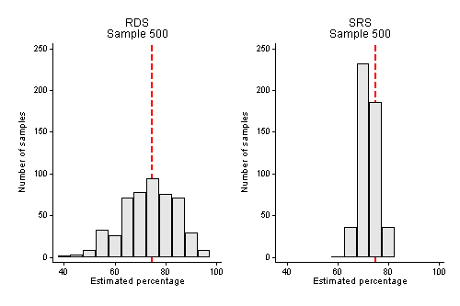
Contrast with SRS

Slide 26
Contrast with SRS (n=400)

Slide 27
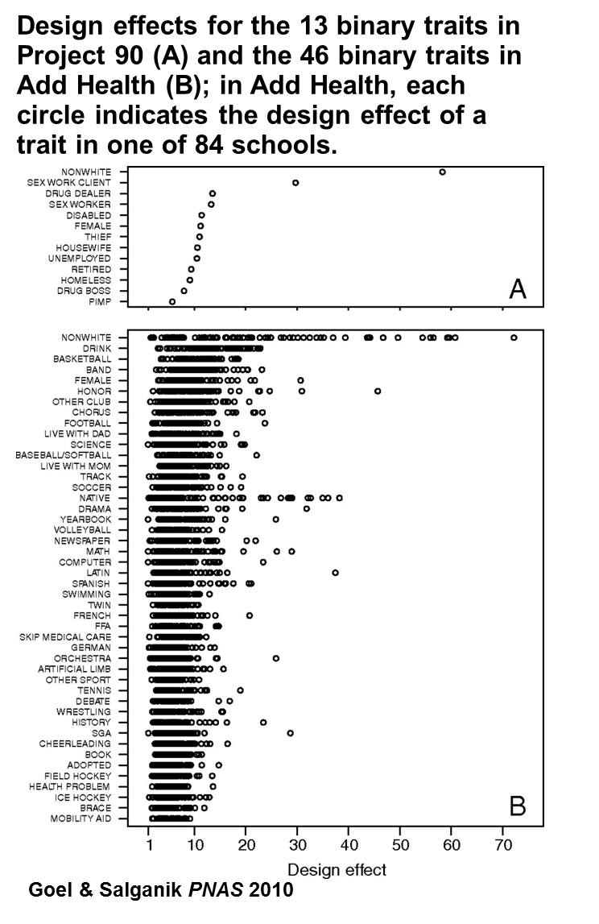
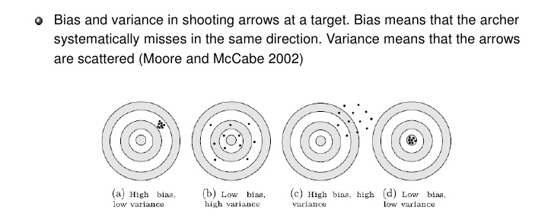
Bias & sampling variance
Early RDS work focused on bias
But sampling variance may be a bigger issue
Design effects
Can be interpreted as sample size multiplier to achieve the same precision as simple random sampling

Slide 28
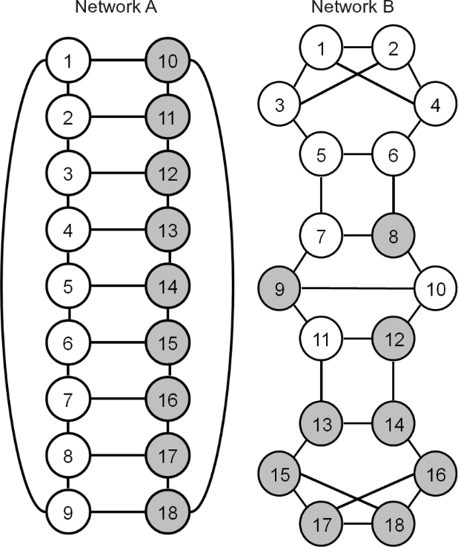
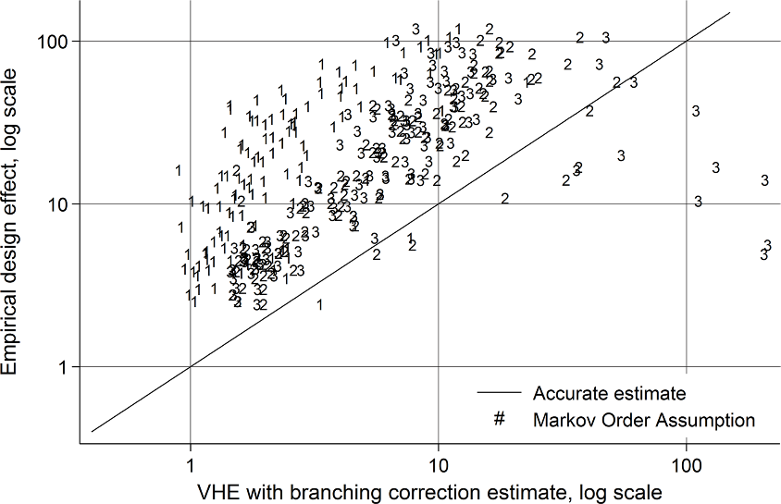
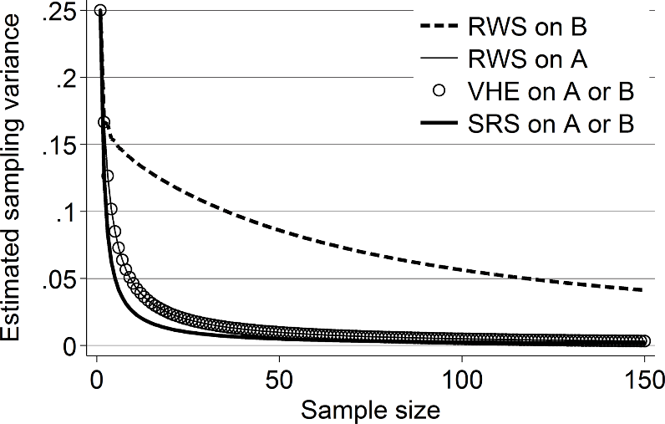
Estimates vs. parameters
Worthwhile distinction
Estimates
Parameters
Example
Sampling variance (SV)
RDS mean estimators have high SV
Estimated sampling variance
RDS SV estimators have high bias
Same problem for homophily estimates
Verdery et al., Plos1 2015

Slide 29
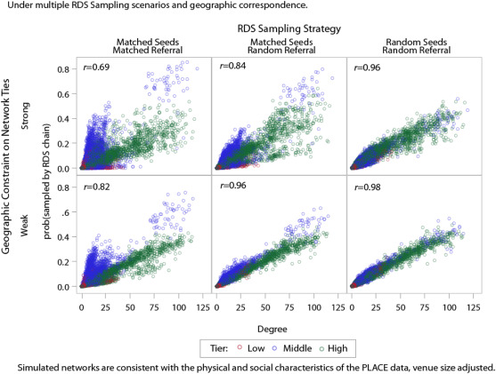

Respondent degree
Key element of most mean estimators
$$w_{i}={d_{i}^{−1}}/{\sum_{i}{d_{i}^{−1}}}$$
Degree
Popularity
How many incoming ties
network assumed undirected
Typical solicitation
“how many people do you know (you know their name and they know yours) who have exchanged sex for money in the past six months?”
Often, successive restrictions
Last 30 days, live in area, etc.
(Merli, et al Soc. Sci. Med. 2015)

Slide 30
Assumption: “random recruitment”
B
3/9
A
3/9
C
3/9
D

Slide 31
In practice: “preferential recruitment”
B
4/9
A
4/9
C
1/9
D

Slide 32
Reasons for preferential recruitment
NOT A REASON
Has more connections to similar people
In principle, the weighting approaches should deal with this
Reasons (not exhaustive)
Better relationships with similar people
Wants to help friend who needs money
Wants friend to get HIV test
Only friends who do riskier things want to get tested
Unemployed friends more likely to be encountered
Etc.

Slide 33
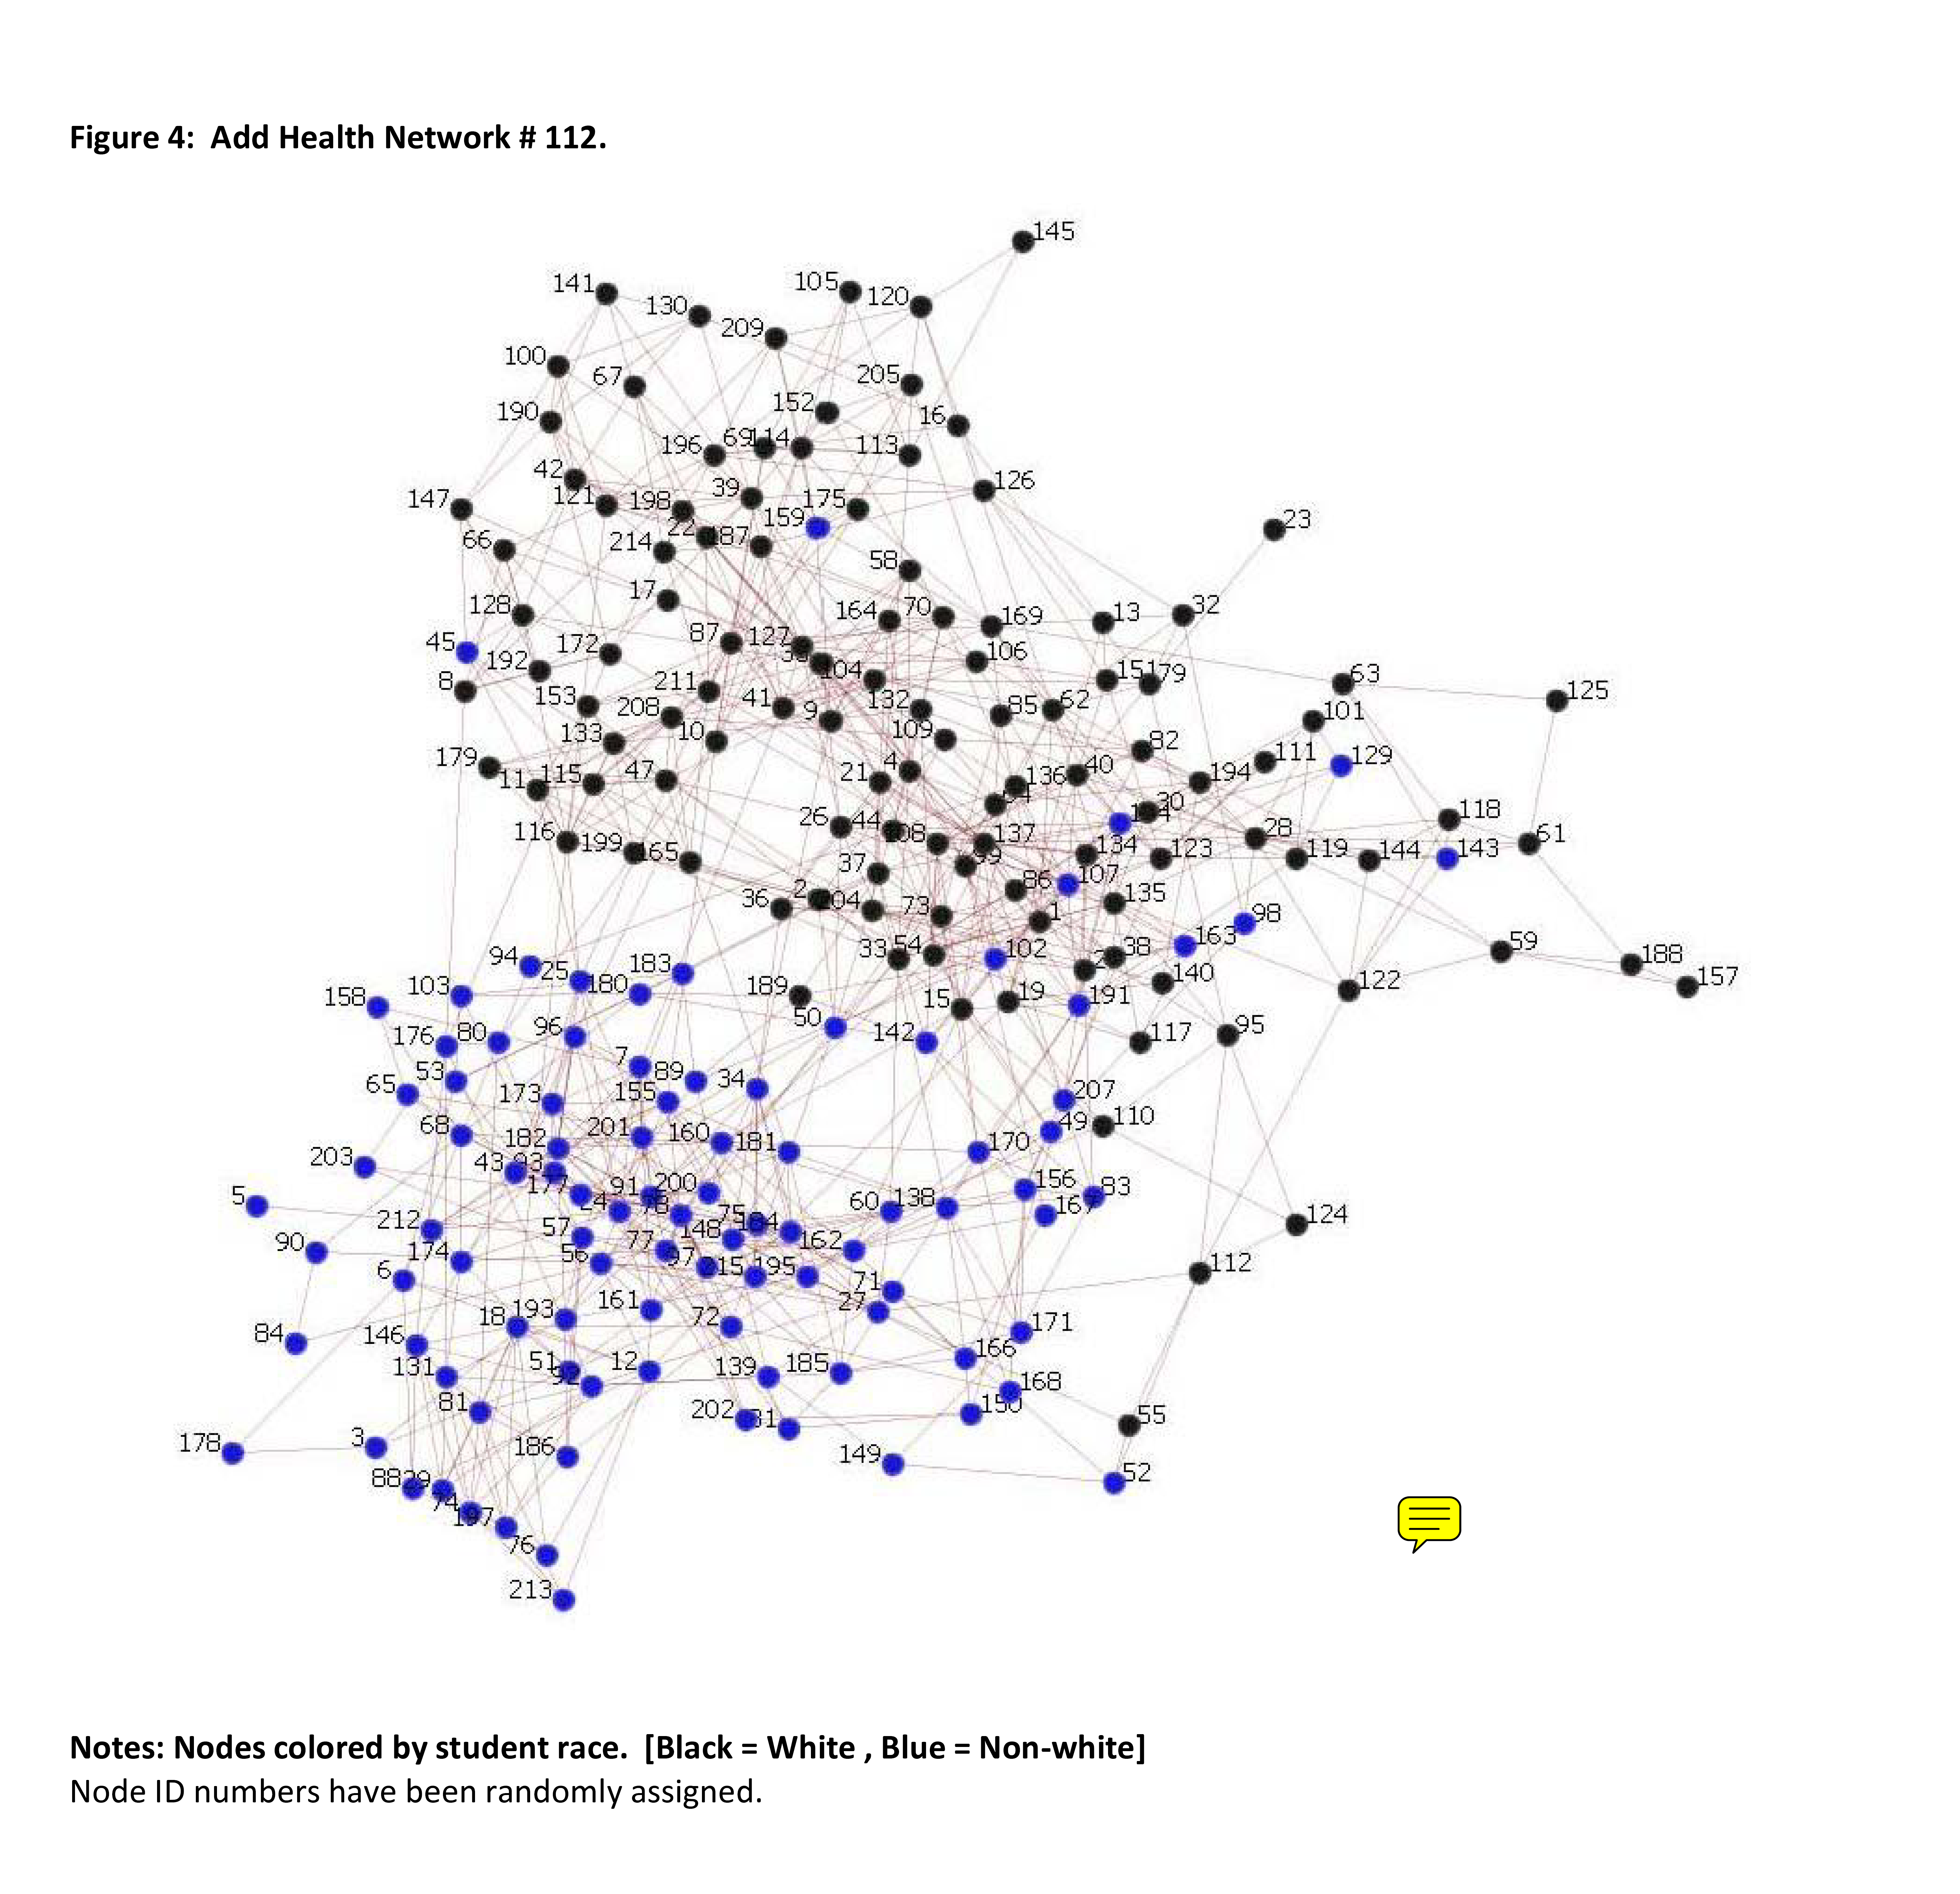
“Bottlenecks”
Few ties between clusters
Assumed to matter substantially
Somewhat overstated
General advice:
Split sample
Tough to achieve a priori
With n=500, rds on this network exhibits 150X the sampling variance of SRS and the estimated sampling variance bears no relation to this, we see this in network after network after network
Mouw & Verdery Soc. Meth. 2012
Salgnik & Goel Stat. Med. 2009

Slide 34
Estimators
Of the population mean
At least 11 in current use
Table on right
McCreesh et al. 2013
Crawford 2016
Gile & Handcock 2015
Berchenko 2017
Of the sampling variance
5 primary methods in use
Bootstrap (Salganik 2006)
Analytical (Volz & Heckathorn 2008)
Successive Sampling (Gile 2011)
Model assisted (Gile & Handcock 2015)
Tree Bootstrap (Baraff et al. 2016)
Verdery, et al., Epid. 2015

Slide 35
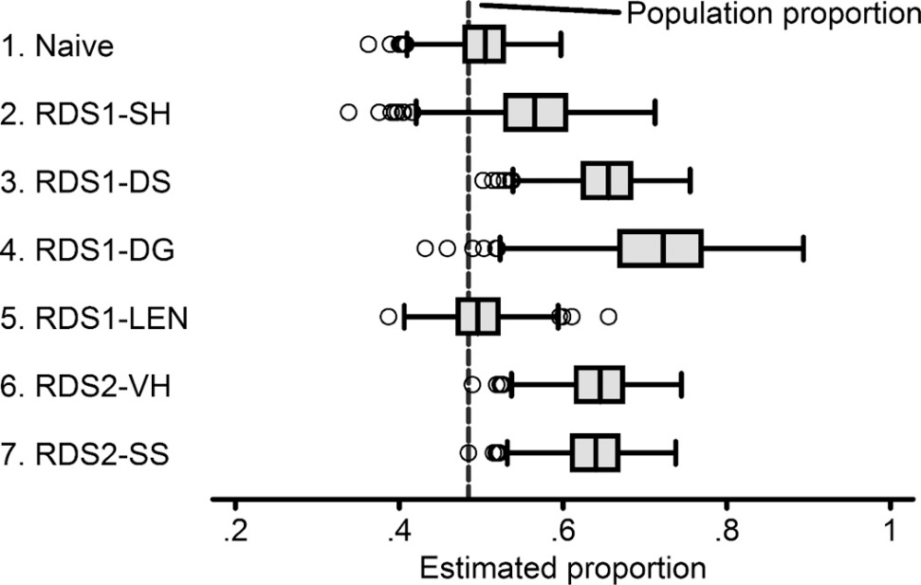
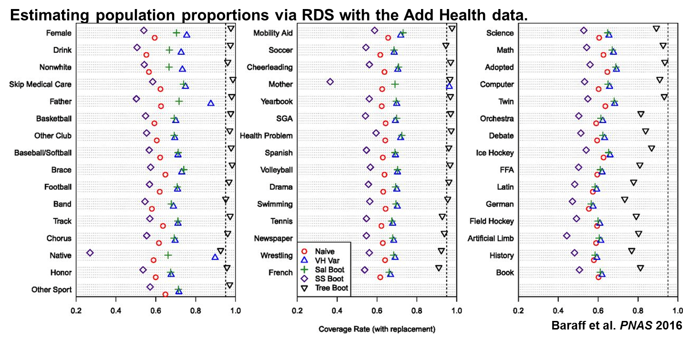
General comments on estimators
For the population mean
“linked ego networks” is best
Requires respondents know peer attributes reasonably well
Can’t calculate for many variables of interest
Naïve estimator often works
Most common
Volz-Heckathorn
Successive Sampling
(In general, SS is better)
For the sampling variance
Only the tree bootstrap method seems to have anything resembling reasonable properties
Verdery, et al., Epid. 2015

Slide 36
Web-based RDS
Developing area
Lots of potential, new pitfalls
Recommendations
Differences from traditional
Be prepared to expand to 30-60 seeds; 20+ waves (generally good)
Verification
Respondent Uniqueness
IP address verification; web-cam interview?
Respondent is in target population
In geographic area of interest? Fits other criteria?
Coupon management
Careful with secondary incentives
Remember limitations
Internet access, etc.
Notes:
See Bengston et al. 2012 for a successful case

Slide 37
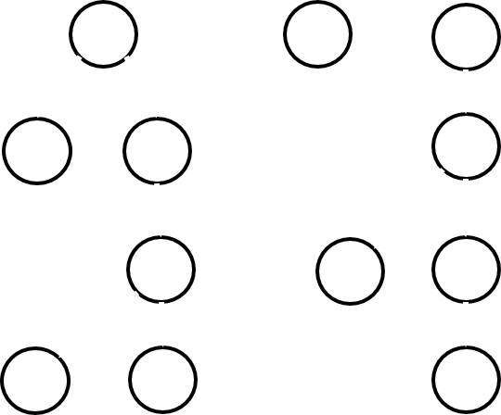
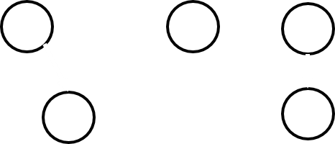
If problems…
Expand recruitment
Expand number of seeds
Allow more than 3 recruits
Raise incentives
Reduce burdens
Greater emphasis on anonymity
Shorten survey
Drop secondary interview
If all else fails…
Convenience sample
Lean on other features
It won’t always look like it does on paper

Slide 38
My recommendations
1) Embed additional data collection in RDS
Qualitative interviews
Ego network rosters
Minimally identifiable information about alters
2) Examine more than just prevalence
Population size
Network structure
Multivariate relationships

Slide 39
Promises & pitfalls
Weighting/estimation can yield asymptotically unbiased estimates of population mean
Unrealistic assumptions required
Assumptions can be very difficult to verify
Some bias in finite samples
Design effects remain high
Orders of magnitude larger N needed
Estimates may be far from parameter
Variance estimators are problematic
But…
New data on understudied populations
Very effective method for drawing samples
Fast samples (50 cases/week)
Possible to learn a lot about networks (underutilized)

Slide 40
Thank you!
Ashton M. Verdery: amv5430@psu.edu
I thank many coauthors: M. Giovanna Merli, James Moody, Ted Mouw, Peter J. Mucha, Jacob C. Fisher, Shawn Bauldry, Nalyn Siripong, Jeff Smith, Kahina Abdessalem, Sergio Chavez, Heather Edelblute, Jing Li, Jose Luis Molina, Miranda Lubbers, Sara Francisco, Claire Kelling, Anne DeLessio-Parson, & David Hunter.
Portions of this work were supported by a grant from the National Institutes of Health (1 R03 SH000056-01; Verdery PI): “Multivariate Regression with Respondent-Driven Sampling Data.”
I also appreciate assistance from the Justice Center for Research, the Institute for CyberScience, the Social Science Research Institute, the College of the Liberal Arts, and the Population Research Institute at Penn State University, the last of which is supported by an infrastructure grant from the Eunice Kennedy Shriver National Institute of Child Health and Human Development (P2CHD041025 & R24 HD041025).
Other portions of this work benefitted from support from the Duke Network Analysis Center, the Duke Population Research Institute, and the Carolina Population Center.

